Slide 1

WELCOME
TO
PRESENTATION

Slide 2
As a requirement of
On
Autonomous driving LEGO vehicle follower
Advanced Real-Time Systems

Slide 3
Presented By:
RTS Project Group-18
Mohammed Shahed Adnan (Mat. Nr. : 1179273)
Project Supervisor:
Prof. Dr. Jens Liebehenschel

Slide 4
Abstraction of Project
We have two LEGO Mindstorm EV3 vehicle. First one is controlled by an android app via bluetooth. Second vehicle follows the first vehicle automatically.

Slide 5
Three parts of the project
Part –A : Mechanical Design & Construction
Part – B : Controlling the 1st vehicle
Part – C : Lego vehicle Follower(2nd vehicle)
Presented by: Mohammed Shahed Adnan(1179273)

Slide 6
Part-A: Mechanical design and construction
We used Lego toy tools to construct the vehicles. LEGO EV3 device is used as the robot kit which is placed at the top of the vehicle. Each vehicle is run by one big motor on four wheels.
Ultrasonic sensor is placed in front of the vehicles
to detect the distance between vehicles smoothly.
Presented by: Mohammed Shahed Adnan(1179273)

Slide 7
Part-A: Mechanical design and construction
LEGO EV3 device has four input port named as 1, 2, 3, 4
And four output port named as A, B, C, D
The Ultrasonic sensor acts as input device and connected to input port 1.
Motor is working as output device and connected to output port D.
Presented by: Mohammed Shahed Adnan(1179273)

Slide 8
Part-A: Mechanical design and construction
To get better reflection for ultra sonic sensor we added a white board at the end of 1st vehicle.
Presented by: Mohammed Shahed Adnan(1179273)

Slide 9
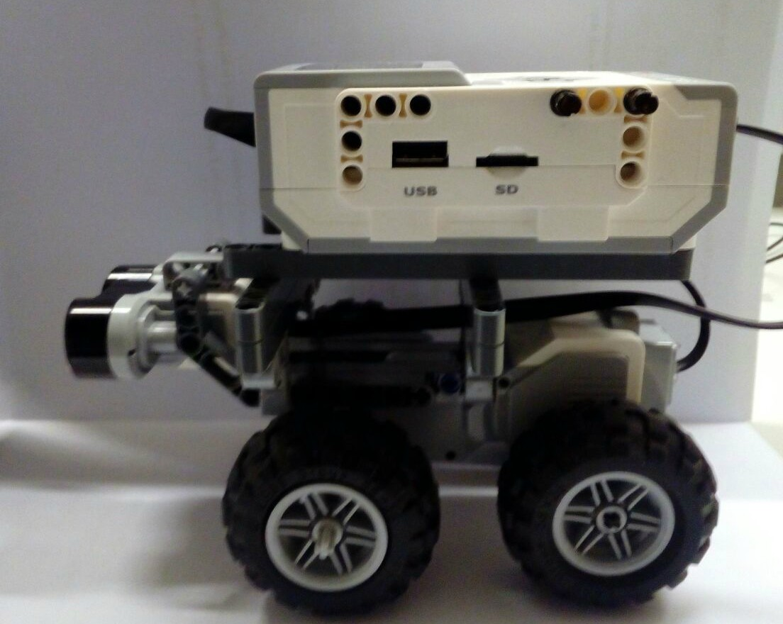
Presented by: Mohammed Shahed Adnan(1179273)

Slide 10
PART –C: LEGO vehicle FOLLOWER
Algorithm:
Step 1: set constant_distance cd, transition_distance td, critical_value
Step 2: turn on Ultrasonic sensor and measure distance
dist= getDistance();
Step 3:
while(flag!=false) {
dist= getDistance();
if(dist>cd+ td) {
while(dist>cd+ td) {
move the vehicle forward;
dist= getDistance();
}
}
else if (cd+ td > dist &&dist>cd) {
while(cd+ td > dist && dist>cd) {
move the vehicle forward slowly;
dist= getDistance();
}
}
Presented by: Mohammed Shahed Adnan(1179273)

Slide 11
PART –C: LEGO vehicle FOLLOWER
else if (dist== cd) {
while(dist==cd) {
move the vehicle forward in certain distance;
dist= getDistance();
}
}
else if(cd>dist && dist>critical_value) {
while(cd>dist && dist>critical_value) {
move the vehicle forward very slowly;
dist= getDistance();
}
}
else if(dist<critical_value) {
while(dist<critical_value) {
stop the vehicle and wait for next action;
dist= getDistance();
}
}
if(dist<.05) {flag=false;break;} // to avoid collision
}
Presented by: Mohammed Shahed Adnan(1179273)

Slide 12
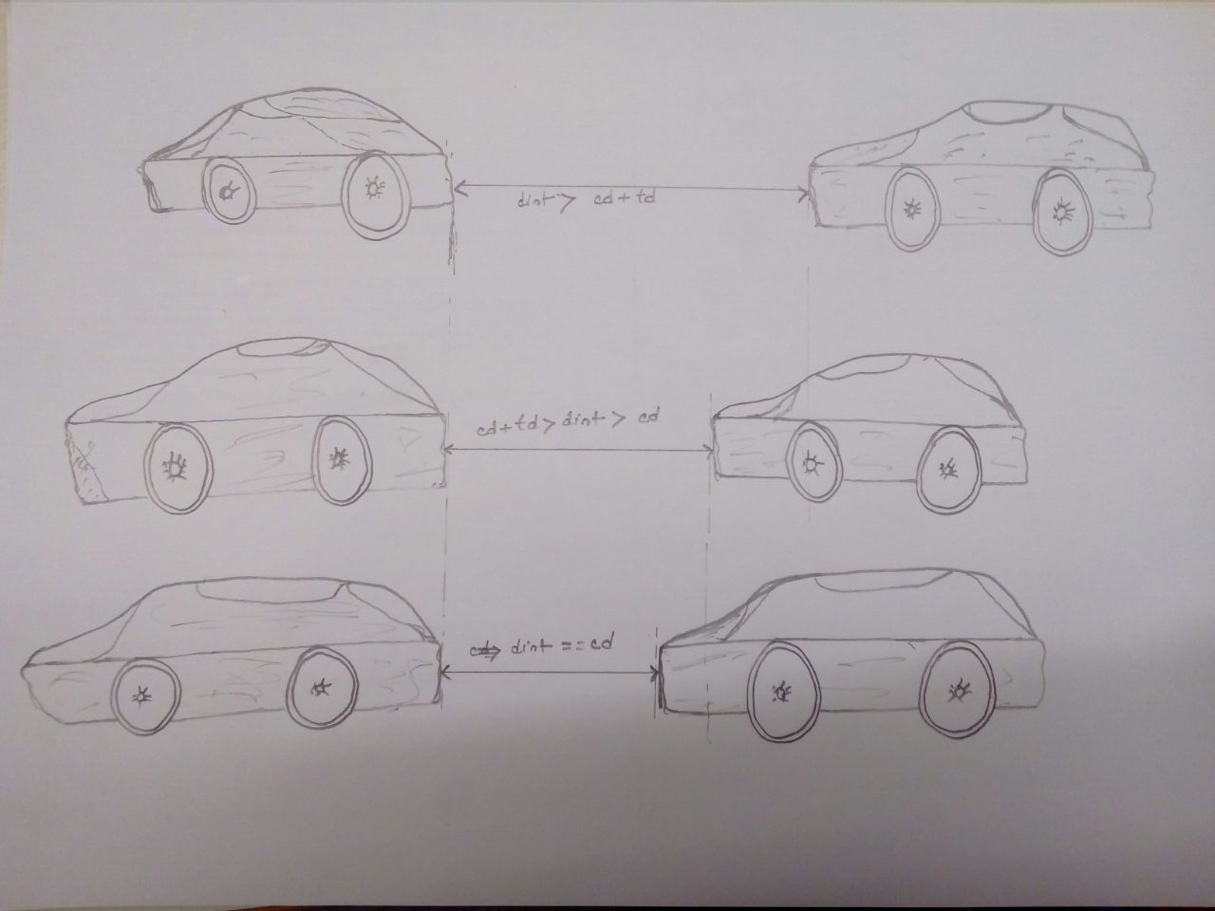
Presented by: Mohammed Shahed Adnan(1179273)

Slide 13
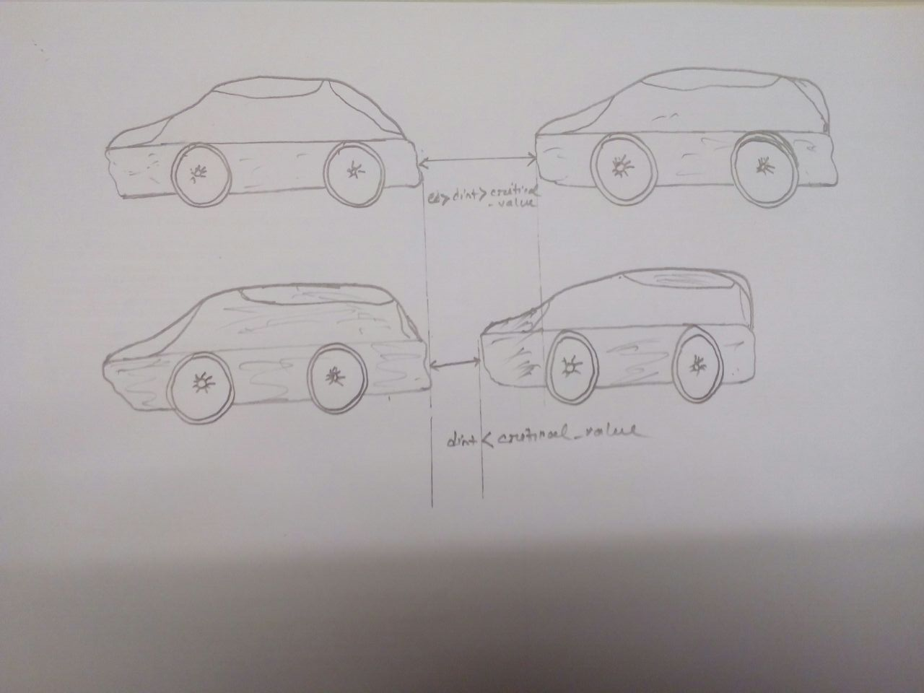
Presented by: Mohammed Shahed Adnan(1179273)

Slide 14
Programming Tools and Language
lejos EV3 based on JAVA
Eclipse IDE
External SD Card: 32 GB
Presented by: Mohammed Shahed Adnan(1179273)

Slide 15
References:
[1] Wi-Fi (IEEE 802.11b) and Bluetooth http://www.ti.com/pdfs/vf/bband/coexistence.pdf
[2] LEGO Mindstorms EV3 Programming Basics
https://www.sos.wa.gov/_assets/library/libraries/projects/youthservices/legomindstormsev3programmingbasics.pdf
[3] LEGO Mindstorms EV3 Programming Basics https://www.elprocus.com/obstacle-avoidance-robotic-vehicle/

